Slide 1
POWER OF SINGLE DECISION
Presenting By: Ayesha khokhar
Roll no. : 4-11/2020/049
Department: cardiac perfusion

Slide 2

What is Decision?
A decision can be define as:
“a course of action purposely choosing from a set of alternatives to achieve organizational or managerial object or goals.”

Slide 3

What is Decision Making?
Decision making can be regarded as the judgmental process resulting in the selection of a course of action.
When trying to make a person must weight the positive and negative of each option, an consider all the alternatives.

Slide 4
Importance of Decision Making
Better utilization recourses
Business growth
Achieving objectives
Increase efficiency
Facilitates innovation
Motivates employees
Solving problems in management
Teamwork

Slide 5
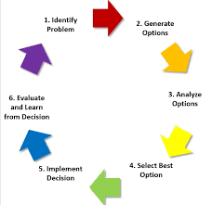
Steps to life changing Decision

Slide 6
THANK YOU

